Slide 1
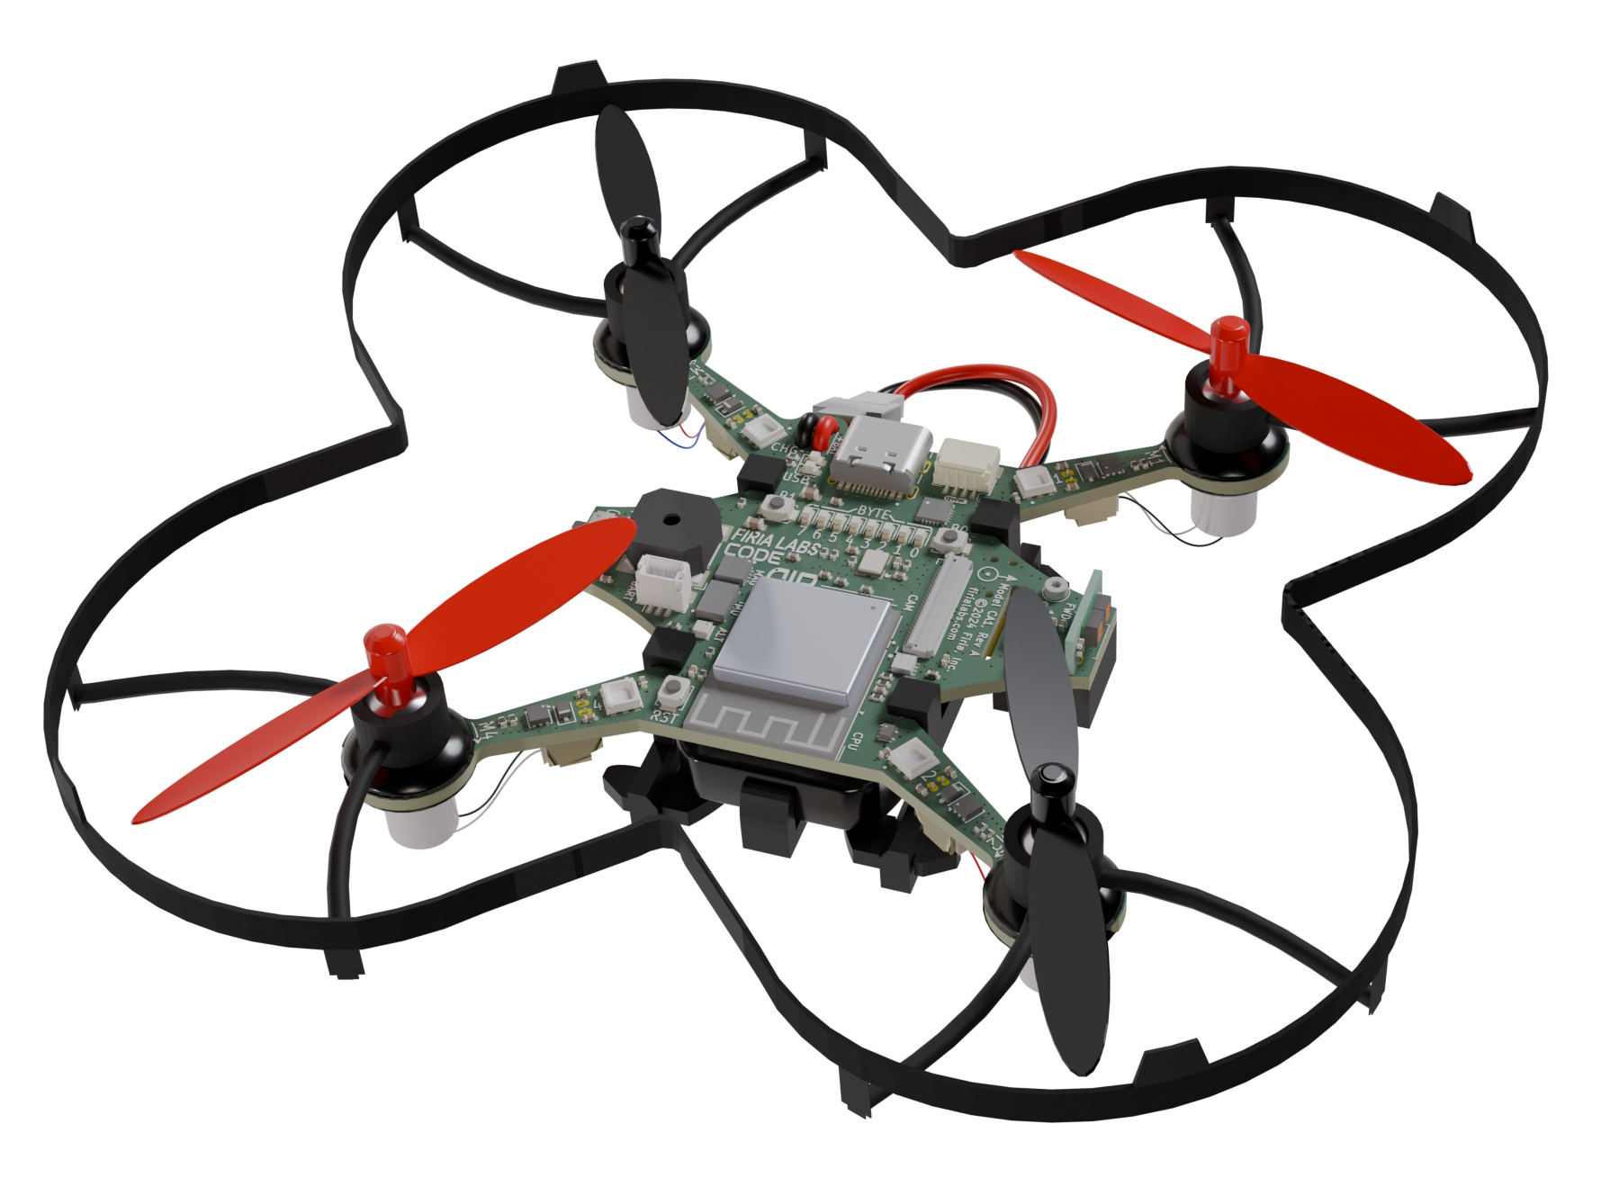
CodeAIR Unit 2 Remix
Create your own project based on Missions 4 and 5

Slide 2
Time for a project remix!
A remix can be:
A new program created by adding new code to a program you already created
You can combine parts of two or more programs in a remix
Use a similar idea in a different way

Slide 3
Project Remix
Creating a remix will let you:
Improve your skills and practice the concepts from the mission
Be creative
Remember code from earlier programs and missions
Work with other students
Design an original program and write the code all on your own

Slide 4
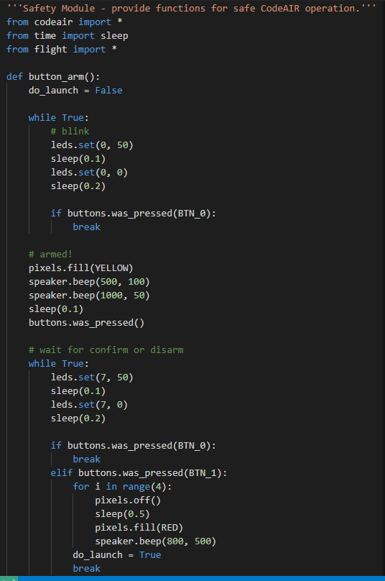
Step #1
Review Mission 4
Open your program from Mission 4
safety.py
DO THIS:
Fill out the information in the Planning Guide for Step 1
What do the programs do?
What skills were used or concepts learned?

Slide 5
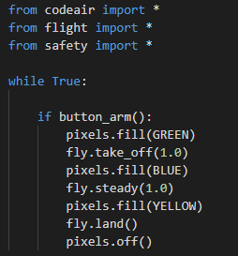
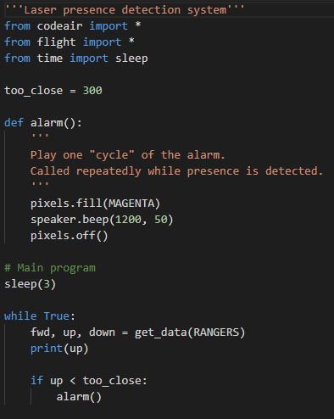
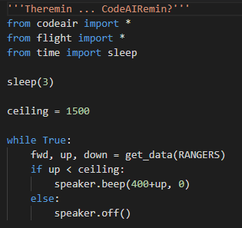
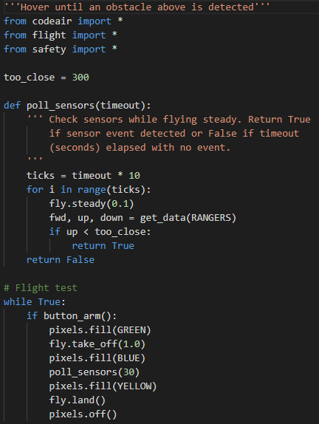
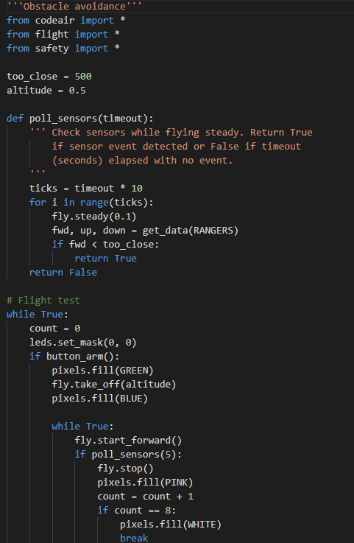
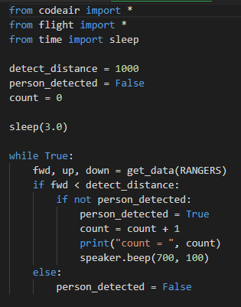
Step #1
Review Mission 5
Open your programs from Mission 5
Hover
Rangers
Ceiling
Theremin
HallMonitor
Avoidance
DO THIS:
Fill out the information in the Planning Guide for Step 1
What do the programs do?
What skills were used or concepts learned?

Slide 6
Step #2
Brainstorm ideas
Review the extensions from each mission. Apply an idea from the extension to a different setting.
Read through remix suggestions on the following slides.
You can use any of these ideas or come up with your own.

Slide 7
Step #2 Remix Ideas
Mission Extensions
Mission 5: Create a more elaborate security system then just checking for something above.
Mission 5: Create a different possible ending to the escape program.

Slide 8
Step #2 Remix Ideas
Mild
Create an escape program where the drone flies right instead of left if a wall is detected. Add another action if a ceiling is detected, and a way to end the escape program.
Medium
Create a security system that is silent while nothing is detected. But if the drone’s sensors detect something, use lights and speaker beeps to sound an alarm. Use different lights and beeps, depending on which sensor detects movement.

Slide 9
Step #2 Remix Ideas
Medium
Create a light show or fireworks display that includes flying in a pattern, lights and speaker beeps. The show should last 1 to 2 minutes.
Spicy
Create a program that is the opposite of avoidance. Have the drone slowly spin or hover until it detects an object. Then the drone will “chase” the object – at a safe distance – until it doesn’t detect anymore. Then it returns to slowly spinning or hovering.

Slide 10
Step #2
Brainstorm ideas
Read through remix suggestions
Use the suggestions –or–
Use your creativity to come up with your own idea for a project
Decide with your partner what project you will do
DO THIS:
Fill out the information in the Planning Guide for Step #2

Slide 11
Step #3
Make a plan
What variables and constants will you need? What will you use them for?
How will you control the blue or pixel LEDs?
What sensors do you need to get information from? How will you use the information?
How and where will you use loops? If statements?
How will you incorporate sounds?
DO THIS:
Fill out the information in the Planning Guide for Step #3
Add to the Planning Guide with more information, as needed

Slide 12
Step #3
Make a plan
DO THIS:
Use a piece of paper to write an algorithm for your project:
What happens first?
What happens next?
etc.

Slide 13
Step #4
Code your project
IMPORTANT: In CodeSpace, go to the sandbox
Start with a new file and give it a descriptive name (Remix2)
You can leave any program open and use it as a guide
Import your modules
Define your variables and constants
Write your code, testing frequently

Slide 14
Step #4
Stop and test frequently!
Don’t try to write all the code at one time
Think about the steps:
Just get one thing to work, then move on
Step by step!
Mistakes happen, so find them early
Type just a few lines of code and then run the program
If there is an error, fix it before continuing
Use your other programs and classmates for help

Slide 15
Step #5
Documentation!
Make sure your code is readable by adding blank lines
Add comments to sections of your code that explain what they do

Slide 16
Step #5
Get feedback
Show your code to other students.
What do they think? Have them fill out the feedback form on your Planning Guide.
The Planning Guide has space for two people to give feedback. The feedback can come from two peers or one peer and yourself.
Use the peer reviews to modify your code and make your project even better

Slide 17
And now you have your own remix!
Congratulations!
By completing this remix you have:
learned more about programming
practiced the skills and concepts from the missions
been thinking! And problem solving and much more!

Slide 18
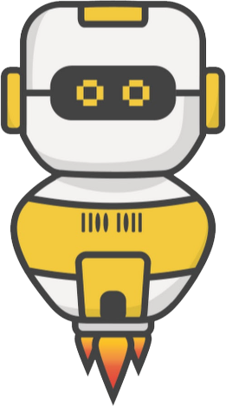
Mission Reflection
Wow! Great job!
Share your project with your friends!
Run projects from other students
Complete the Reflection in the Planning Guide

